Slide 1
Campaign kit
How to make your brand the hero
Version 1.0 / May 2023

Slide 2
Table of contents
03 Numbers from Nordic Consumer Survey (Ipsos 2022)
05 A new tagline
06 The campaign kit
08 Copy-texts that makes your brand the hero
09 Graphic guidelines
10 Example mock-up ads
11 Inspiration for social media
13 Internal activation
15 Contact information

Slide 3
Your brand carries a label that is a well known and trusted brand among Nordic consumers
95 %
67 %
of Nordic consumers know the Nordic Swan Ecolabel.
of those who know the Nordic Swan Ecolabel trust the label.
60 %
58 %
of the Nordic consumers look for the Nordic Swan Ecolabel when they are to choose among products.
of the Nordic consumers are concerned about what they personally can do to protect the environment.
Nordic Consumer Survey on assignment from Nordic Ecolabelling (IPSOS 2022)

Slide 4
You are the heroes – the brands that made it
This is the first Nordic advertising campaign ever. A joint effort from all Nordic countries to spread the word, with one voice, about the Nordic Swan Ecolabel. In this campaign we will tell the story of the Nordic Swan Ecolabel through the voices of products and services that have attempted to get a Nordic Swan Ecolabel licence. Not through those who have succeeded and received an ecolabel, but above all, through the products and services that did not make it. But as you all know – you are the ones who made it. And the purpose of this campaign kit is to emphasize you as the heroes.
By positioning your own brand next to The Nordic Swan Ecolabel, a brand that is recognized by 95% of the Nordic consumers and that 60% look for when they choose among products, you will earn both credibility and recognition. Use this opportunity to strengthen your own brand.

Slide 5
New tagline: Hard to get. Easy to choose.
New tagline – that makes your brand the hero Hard to get. Easy to choose.
Positions the Nordic Swan Ecolabel as the stricter eco-label and tells our audience that we make it easier for the consumers in their everyday choices.
Positions the Nordic Swan Ecolabel as the stricter eco-label and tells our audience that we make it easier for the consumers in their everyday choices.
Notes:
Positionerar Svanen som den strängaste miljömärkningen och berättar att Svanen gör det enkelt för dig att göra bättre val för miljön, klimatet och din hälsa.
Positions the Nordic Swan Ecolabel as the stricter eco-label and tells our audience that we make it easier for the consumers in their everyday choices.

Slide 6
The campaign kit
Copy-texts and campaign logos that makes your brand the hero

Slide 7
How to make your brand the hero
First of all – be proud of your Nordic Swan Ecolabel! Communicate your hard work and all the requirements you have fought so hard to achieve.
Tell the story about your product or service and the Nordic Swan Ecolabel. How you go way back, or just got to know each other. How you inspire and challenge each other.
Tell the story about how your product or service can be trusted as a better environmental choice since it carries Nordic Swan Ecolabel. They carry the Nordic Swan Ecolabel and are therefore easy to choose for all consumers that wants to make better choices for the environment, the climate and their health.
In this campaign kit you will find assets that works perfectly for these purposes – but you may of course choose to tell your story in a whole different manner. But you can be sure that these assets make it easier for you to make your brand the hero.
The different assets can be downloaded from here: www.nationalpage
Use the assets in this campaign-kit. You can use them in ads or in your own channels – pretty much everywhere! Make your own material, using the assets we’ve provided you with.
And feel free to share our videos and SoMe-posts in your own channels.

Slide 8
Copy-text that makes your company the hero
We have created copy texts in three different lengths, all designed to make your brand the hero. Feel free to use these copy texts as you like when you communicate your products or services that are labelled with the Nordic Swan Ecolabel.
Maxi
We chose the Nordic Swan Ecolabel because it is one of the world’s toughest environmental certifications.
We did it for you.
And the environment.
Considering only one environmental aspect is difficult enough, but the Nordic Swan Ecolabel considers all the relevant ones, from resources and chemicals to climate and biodiversity. To further complicate things: Have you heard the term “lifecycle perspective”? Well, we have. It means to consider all stages of a product’s life from raw materials, production, and use to re-use, recycling and waste.
We are proud we made it.
Midi We chose the Nordic Swan Ecolabel because it is one of the world’s toughest environmental certifications.
We did it for you.
And the environment.
Considering only one environmental aspect is difficult enough, but the Nordic Swan Ecolabel considers all the relevant ones, from resources and chemicals to climate and biodiversity – throughout the entire product’s life.
We are proud we made it.
Mini
We chose the Nordic Swan Ecolabel because it is one of the world’s toughest environmental certifications.
We did it for you.
And the environment.
We are proud we made it.

Slide 9
Graphic guidelines
Only use the campaign logo in relation to products or services who are Nordic Swan Ecolabelled.
It must be clear, which products or services are ecolabelled, and who the sender of the communication is.
The placement of the campaign logo depends on whether all products or services in the marketing material are ecolabelled or only some of them.
If not all products or services in the marketing material are ecolabelled, it must be clear, which products are ecolabelled and which are not. Balance the prominence of the campaign logo and your own logo and identity.
The campaign logo can be used in all kind of your marketing material.
If you want the logo with the English logo
“Hard to get. Easy to choose.” Send us an email ☺

Slide 10
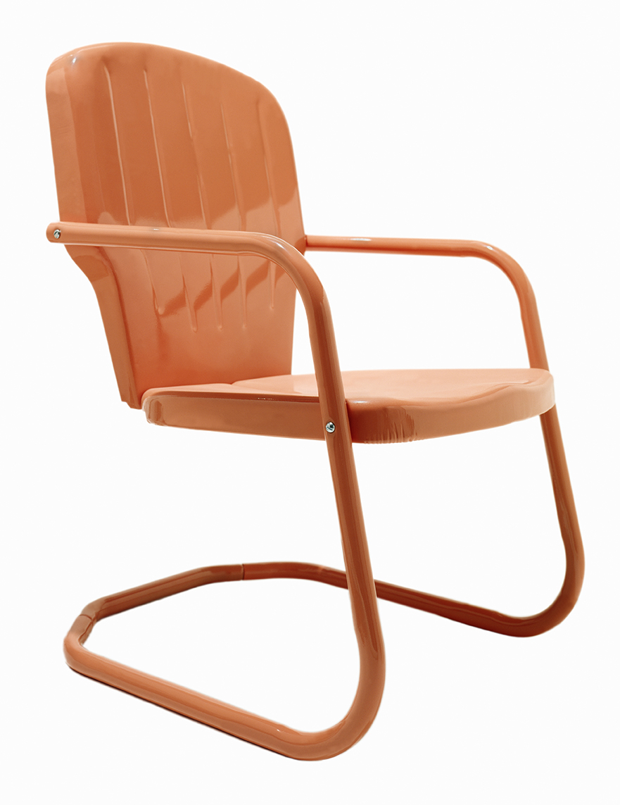
Example mock-up ads
Yes, we made it!
We chose the Nordic Swan Ecolabel because it is one of the world’s toughest environmental certifications
We did it for you. And the environment.
Considering only one environmental aspect is difficult enough, but the Nordic Swan Ecolabel considers all the relevant
ones, from resources and chemicals to climate and biodiversity.
To further complicate things: Have you heard the term “lifecycle perspective”? Well, we have. It means to consider all stages of a product’s life from raw materials, production, and use to re-use, recycling and waste.
We are proud we made it.
We chose the Nordic Swan Ecolabel because it is one of the world’s toughest environmental certifications.
We did it for you.
And the environment.
Svår att få. Lätt att välja.
Svår att få. Lätt att välja.

Slide 11
Inspiration for social media – example posts
Here are additional inspirational copy text primarily for social media, of course designed to make your brand the hero. Feel free to use the texts when you communicate your products and services that are labelled with the Nordic Swan Ecolabel in social media
Example 3 It’s not easy being green. But we’re not looking for easy, we want to do better – better for the environment, better for you. That’s why the Nordic Swan Ecolabel and its tough environmental criteria are so important to us. Read more about what the Nordic Swan Ecolabel means for us/Get to know the Nordic Swan Ecolabel/Check out our ecolabelled products/services: link
We choose the Nordic Swan Ecolabel not because it’s easy, but because it’s hard. We may not go to the moon, but we work everyday to make more environmentally conscious choices easier for you to choose. The Nordic Swan Ecolabel – hard to get, easy to choose.
Example 2 We choose the Nordic Swan Ecolabel not because it’s easy, but because it’s hard. We may not go to the moon, but we work everyday to make more environmentally conscious choices easier for you to choose. The Nordic Swan Ecolabel – hard to get, easy to choose.
Example 1 We choose the Nordic Swan Ecolabel – and they chose us! Many/dozens/all of our products have passed the Nordic Swan Ecolabel’s tough criteria. We’ve done the hard work to push ourselves forward – and to make better choices easier for you.
Notes:
We choose the Nordic Swan Ecolabel not because it’s easy, but because it’s hard. We may not go to the moon, but we work everyday to make environmentally conscious choices easier for you. The Nordic Swan Ecolabel – hard to get, easy to choose.
We chose the Nordic Swan Ecolabel – and they chose us! Many/dozens/all of our products have passed the Swan’s tough criteria. We’ve done the hard work to push ourselves forward – and to make good choices easier for you.
It’s not easy being green. But we’re not looking for easy, we want to do better – better for the environment, better for you. That’s why the Nordic Swan Ecolabel and it's tough environmental criteria are so important to us. Read more about what the Swan means for us/Get to know the Nordic Swan Ecolabel/Check out our ecolabelled products/services: link

Slide 12
Here is how you can use the campaign for your advantage
Examples from the other Nordics
The different assets can be downloaded from here: www.nationalpage
Notiði það sem finna má í þessu herferðarsetti, í eigin auglýsingar eða á eigin miðla - hvar sem er!
Og ekki hika við að deila myndböndum Svansins á ykkar eigin miðla
Country: Norway
Licence holder: Kährs Norge
Country: Denmark
Licence holder: Stadsing
Country: Sweden
Licence holder: Depend Cosmetic
Country: Finland
Licence holder: Gasum Oy

Slide 13
#nationaloptions
Remember to use the hashtag and tag our accounts on your social media posts! Many posts at the same time, with the same message – to choose products and services with the Nordic Swan Ecolabel – will make a great impact.
Instagram: national options
Facebook: national options
LinkedIn: national options
You are welcome to link to our campaign site:
www.nationaloption
Notes:
DK #svanemærket FI #joutsenmerkki IC #svanurinn NO #svanemerket SE #svanenmärkt

Slide 14
Internal activation
You should be proud of your Nordic Swan Ecolabel and share your efforts with your colleagues! The campaign gives you the opportunity to create internal awareness, interest and commitment to your sustainability initiatives.
Introduce all (new) employees to the Nordic Swan Ecolabel with for example educational material, information signs, campaign videos etc. Review your own purchases and procurement and prioritise ecolabelled suppliers in printing, laundry, work clothes, office supplies, furniture, etc.

Slide 15
Stay in touch!
Ester Alda Hrafnhildar Bragadóttir
Advisor
591-2023
ester.alda.hrafnhildar.bragadottir@umhverfisstofnun.is
svanurinn@umhverfisstofnun.is

